Slide 1




Reflection
Programming under the hood
SoftUni Team
Technical Trainers
Software University
http://softuni.bg

Slide 2

Table of Contents
What is reflection?
Pros and cons
Using reflection
Assemblies
Types and members
Dynamic invocation
Generics
Example: Unit Testing System

Slide 3
Reflection
A way of inspecting and modifying the program behaviour at runtime
Inspecting and changing the values of variables
Inspecting compiled metadata in an assembly
Invoking methods
Assembly (.exe or .dll)
Module
Assembly Manifest
(name, version, culture)
Metadata (info for all of the assembly types)
Resources (optional) (text files, images, strings)

Slide 4
Reflection Usages
Reflection is commonly used to
Examine assembly metadata
Examine types
Invoke methods dynamically
Inspect an object at runtime without knowing its class
Examples
ASP.NET MVC, Entity Framework, decompilers, debuggers, testing frameworks…

Slide 5
Costs of Using Reflection
Reflection may be good but comes at a price
Writing more code
Code which executes more slowly
“Golden Hammer” antipattern
Over-reliance on a familiar tool
A lot of casting and type checks
Makes it even slower
Possible “magic strings”

Slide 6
Best Practices
First, try not to use reflection :)
Try to cache all reflected metadata
Dynamically load assemblies and types only once
Usually at startup
Cast types to a known interface
All method calls go through the interface
Avoid MethodInfo.Invoke() and private members – they are slow
Balance between performance, safety, and flexibility

Slide 7
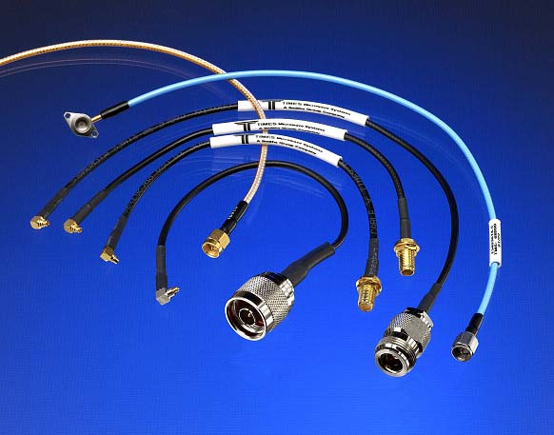
Loading Assemblies
Load libraries dynamically

Slide 8
The Assembly Class
Assembly.Load(…) – loads existing assembly by name or AssemblyName object
If it fails to find it, throws a FileNotFoundException
Assembly.LoadFrom(…) – loads existing assembly by path
If it fails to find it, throws a FileNotFoundException
Assembly sampleAssembly =
Assembly.Load(“SampleAssembly, Version=1.0.2004.0, Culture=neutral,PublicKeyToken=8744b20f8da049e3”);
Assembly myAssembly = Assembly.LoadFrom(@“C:\Tools\MyAssembly.dll”);

Slide 9
Assembly Properties
System.Reflection.Assembly
FullName – name, version, culture, public key token
Location – file from which the assembly is loaded
EntryPoint – the starting / Main() method
GlobalAssemblyCache – indicates whether the assembly has been loaded from the GAC
A collection of assemblies shared between applications

Slide 10
Loading Assemblies
Live Demo

Slide 11

System.Type
Inspecting and Modifying Types

Slide 12
The System.Type Class
System.Type is a starting point for inspecting .NET types
Fields, methods, properties, events, inner types, etc.
Assembly.GetTypes() – lists all types in the given assembly
System.Type Properties
BaseType, Attributes, Name, FullName, IsClass, IsEnum, IsInterface, IsAbstract, IsSealed, IsVisible…
System.Type Methods
GetConstructors(), GetFields(), GetProperties(), GetEvents(), GetMethods(), GetCustomAttributes()…

Slide 13
Examples
Inspecting type members
Invoking a private method
Assembly currentAssembly = Assembly.GetExecutingAssembly();
foreach (Type type in currentAssembly.GetTypes())
{
Console.WriteLine("== {0}:", type.Name);
foreach (MemberInfo member in type.GetMembers())
{
Console.WriteLine("{0}: {1}", member.MemberType, member.Name);
}
}
MethodInfo[] methods = typeof(MyClass).GetMethods(BindingFlags.NonPublic | BindingFlags.Instance);

Slide 14
Inspecting Type Members
Live Demo

Slide 15
MemberInfo Hierarchy
System.Reflection.MemberInfo
System.Reflection.EventInfo
System.Reflection.FieldInfo
System.Reflection.MethodBase
System.Reflection.ConstructorInfo
System.Reflection.MethodInfo
System.Reflection.PropertyInfo
System.Type

Slide 16
Inspecting Methods
Type.GetMethod(…) – returns the reflection of a method
Returns a MethodInfo object
MethodInfo.GetParameters() – returns a collection of all parameters for the given method
Returns a ParameterInfo object
MethodInfo method = myType.GetMethod(“SomeMethod”);
foreach(ParameterInfo param in method.GetParameters())
{
Console.WriteLine(param.ParameterType);
}

Slide 17
Dynamic Method Invocation
Instantiating an object – Activator class
CreateInstance(…)
Creates an instance of the given type (string or Type object)
CreateInstanceFrom(…)
Creates an instance of the given type from the given assembly
MethodInfo.Invoke()
Dynamically invokes a method
Can be used for both static and instance methods

Slide 18
Examples
public class MyClass
{
static void Main()
{
var type = typeof(MyClass);
type.GetMethod("InstanceMethod")
.Invoke(new MyClass() { }, null);
type.GetMethod("InstanceMethodWithParameters")
.Invoke(new MyClass() { }, new[] { "param" });
type.GetMethod("StaticMethod")
.Invoke(new Program() { }, null);
}
public void InstanceMethod(){ … }
public void InstanceMethodWithParameters(string param){ … }
public static void StaticMethod(){ … }
}

Slide 19

Dynamic Method Invocation
Live Demo

Slide 20
Working with Generics
Reflection supports generic types
Can get the generic parameters at runtime
Some of the generic reflection methods:
MethodInfo.IsGenericMethod()
MethodInfo.GetGenericArguments()
Type.IsGenericType()
Type.GetGenericTypeDefinition()
Converts MyType<int> to MyType<T>

Slide 21

Unit Testing System
Live Demo

Slide 22
Reflection
https://softuni.bg/courses/oop

Slide 23
License
This course (slides, examples, demos, videos, homework, etc.) is licensed under the "Creative Commons Attribution-NonCommercial-ShareAlike 4.0 International" license
Attribution: this work may contain portions from
"Fundamentals of Computer Programming with C#" book by Svetlin Nakov & Co. under CC-BY-SA license
"OOP" course by Telerik Academy under CC-BY-NC-SA license

Slide 24







SoftUni Diamond Partners

Slide 25




Free Trainings @ Software University
Software University Foundation – softuni.org
Software University – High-Quality Education, Profession and Job for Software Developers
softuni.bg
Software University @ Facebook
facebook.com/SoftwareUniversity
Software University @ YouTube
youtube.com/SoftwareUniversity
Software University Forums – forum.softuni.bg

